Slide 1


Computer Organization & Architecture
Chapter 10
Instruction Sets:
Characteristics and Functions

Slide 2
10.1 Machine instruction characteristics
What is The Instruction Set Architectures?
  The attributes of a system as seen by the programmer, i.e., the conceptual structure and functional behavior, as distinct from the organization of the data flows and controls, the logic design, and the physical implementation.
- Amdahl, Blaaw and Brooks, 1964
  ... the portion of the machine visible to the programmer or compiler writer.
- Hennessey and Patterson, 1990

Slide 3
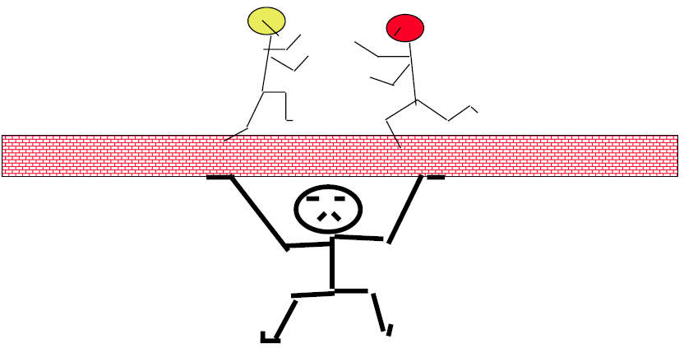
Software
ISA
Hardware

Slide 4
Instruction Set
  The collection of instructions that CPU can execute
    The instruction set determinates the function of CPU
  Machine Code, Binary
  For convenience, usually represented by assembly codes

Slide 5
Elements of an Instruction
  Operation code (Op code)
    Do this
  Source Operand reference
    To this
  Result Operand reference
    Put the answer here
  Next Instruction Reference
    When you have done that, do this...
    Branch instruction
    PC

Slide 6
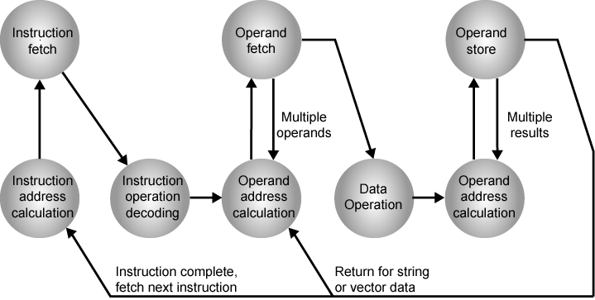
Instruction Cycle State Diagram

Slide 7
Where are all the Operands?
  Cache or main memory or virtual memory
  CPU registers
    If only one register exists, reference to it may be implicit
    For many registers, each is assigned a unique number
  I/O device
    The instruction must specify the I/O module & device or another memory address for the operation

Slide 8
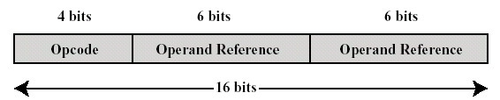
Instruction Representation
  In machine code, each instruction has a unique bit sequence
  The instruction is divided into fields such as the following format:

Slide 9
  It is difficult for both the programmer and readers to deal with binary code of machine instructions ,thus, a symbolic representation is used
    e.g. ADD, SUB, MPY,DIV
    LOAD,STOR,etc.
  Operands can also be represented in this way
    ADD A,B

Slide 10
Instruction Types
  Data processing
  Data storage (main memory)
  Data movement (I/O)
  Program flow control: test and branch
  Any data-processing task may be expressed by above instructions
  Any program written in high-level language may be translated into above instructions

Slide 11


Number of Addresses
  4 addresses
    Simple and intuitionistic
    Almost no implementation
  32-instruction, the first byte is always opcode
    4 times access main memory
    Address space 2⁶ = 64

Slide 12


Number of Addresses
  3 addresses
    next instruction address is usually implicit
    Not common
    4 times access main memory
    Address space 2⁸ = 256

Slide 13




  2 addresses
    or
    or
    One address doubles as operand and result
    Reduces length of instruction
    Sometimes, requires some extra work:
      using MOV instruction
      Temporary storage to hold some results
    4 times access main memory
    Address space 2¹² = 4K

Slide 14



  1 address
    or
    Implicit second address
    Usually a register (accumulator,AC)
    Common on early machines
    E.g : AC← AC OP A
    2 times access main memory
    Address space 2²⁴ = 16M

Slide 15
  0 (zero) addresses
    Opcode
    All addresses implicit or no address
    Uses a stack
    0 addresses instructions would reference top two units of stack
    E.g. T ← TOP (T-1)
    NOP

Slide 16
How Many Addresses?
  More addresses
    More complex (powerful?) instructions
    More registers
      Inter-register operations are quicker
    Fewer instructions per program
  Fewer addresses
    Less complex (powerful?) instructions
    More instructions per program
    Faster fetch/execution of instructions,but the program is longer , more complicated and slower
  Modern computers adopt two- or three-address instructions

Slide 17
Instruction Set Design Decisions
  Operation repertoire
    How many ops?
    What can they do?
    How complex are they?
  Data types
    Addresses,Numbers, Characters, Logical Data
  Instruction formats
    Length of op code field
    Number of addresses

Slide 18
  Registers
    Number of CPU registers available
    Which operations can be performed on which registers?
  Addressing modes (later…)
  RISC v CISC

Slide 19
10.2 Types of Operands
Addresses
  Unsigned integer
Numbers
  Integer/floating point/decimal
  Using decimal can avoid conversion
  Many machines support packed decimal
      4 bits binary code→ a decimal digit
      246=0010 0100 0110
Characters
  ASCII, EBCDIC, etc.
Logical Data
  Bits or flags
  Boolean

Slide 20
10.3 Pentium and PowerPC data type
Leave to study by yourself

Slide 21
10.4 Types of Operations
Data Transfer
Arithmetic
Logical
Conversion
I/O
System Control
Transfer of Control

Slide 22
Data Transfer
  Data transfer instructions are the most fundamental type of machine instruction
  Specify
    Source
    Destination: registers,memory, top of stack
    Amount of data
    Mode of addressing
  Data transfer instructions
    Move
    Store
    Load
    Exchange:swap contents of source and destination
    Clear : all 0
    Set: all 1
    Push/pop

Slide 23
Arithmetic
  Add, Subtract, Multiply, Divide
    Signed Integer
    Floating point
  May include
    Increment (a++) INC(X86,51)
    Decrement (a--) DEC(X86,51)
    Negate (-a) NEG(X86) CPL(51)
    absolute

Slide 24
Logical
  Bitwise operations/Boolean operations
  AND, OR, NOT, Exclusive-OR
  Test, compare
  Set control Variables: set controls for protecting purpose, interrupt handling, timer control, etc.
  Shift
  Rotate shift

Slide 25
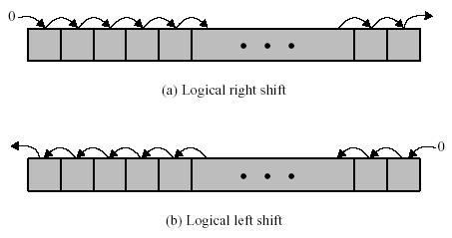
Logical Shift (SHL,SHR) (X86)
if ((num>>1)<<1==num)

Slide 26
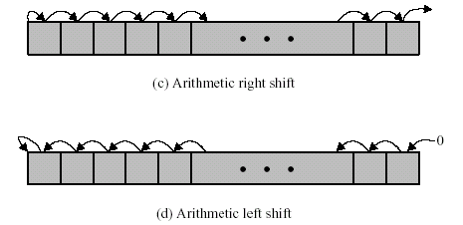
Arithmetic Shift (SAL,SAR) (X86)

Slide 27
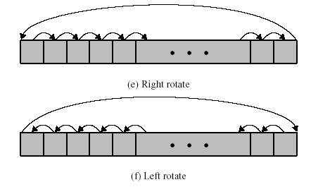
Cyclic Shift (ROL,ROR) (X86)

Slide 28
Conversion
  Convert
    Base conversion
    E.g. Binary to Decimal
  Translate
    Some values in memory are converted by table query
    ASCII→EBCDIC

Slide 29
Input/Output
  Input/read IN(51)
  Output/write OUT(51)
  Start I/O
  Test I/O
  May be specific instructions
  May be done using data movement instructions (memory mapped)
  May be done by a separate controller (DMA)

Slide 30
Systems Control
  Privileged instructions
  CPU needs to be in specific state
    Update control register
  For operating systems use
    Schedule a process
    Update PCB
  E.g. SMSW DST, LMSW DST

Slide 31
Transfer of Control
  Branch/jump
  Jump conditional
  Jump to subroutine
  Return execute
  Skip
  Skip conditional
  Halt
  Wait(hold)
  No operation
  JMP, JC, JNZ

Slide 32
Procedure Call Instruction
  A procedure is a self-contained computer program that is incorporated into a larger program
    Code reuse
    Task decomposing
  Procedure Call Instruction is a jump instruction
    A call instruction
    A return instruction

Slide 33
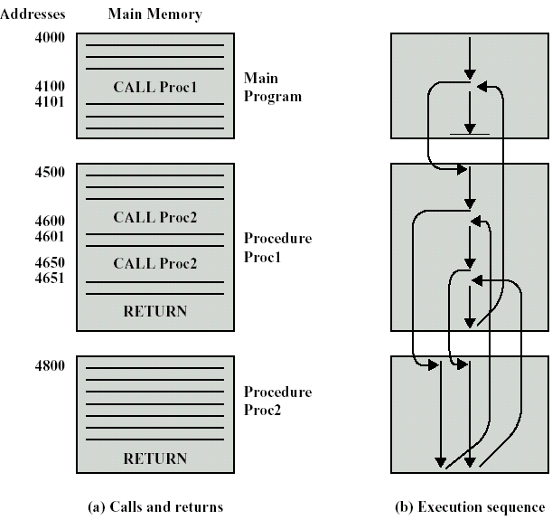
Nested Procedure

Slide 34
Return Address
  For correctly executing main program’s sequence, the return address must be protected
  Three main methods:
    Register
    Start of procedure
    Top of stack

Slide 35
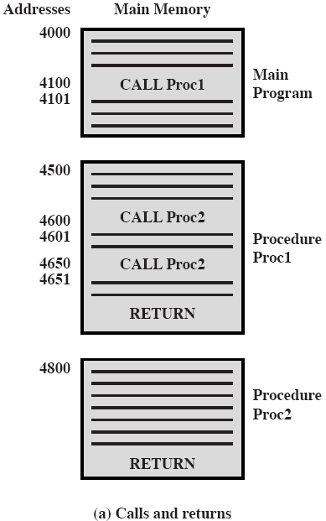

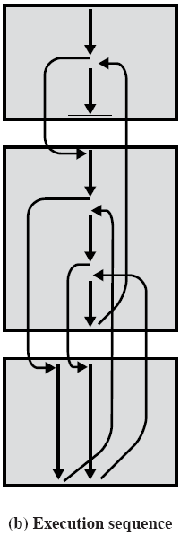

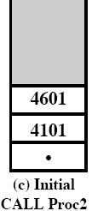




Stack & Return Address

Slide 36
10.5 Pentium II Operation Types
Pp.356~357 – table 10.8
No need to remember

Slide 37
MMX Techniques
  MMX—MultiMedia eXtension
  A set of highly optimized instructions for multimedia applications
  57 SIMD instructions, 64-bit data field
  Perform the same operation on multiple data elements at once in a single clock cycle(SIMD)
  For proper applications, these parallel operations can yield a speedup of 2~8 times

Slide 38
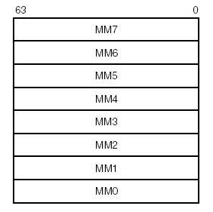
MMX Registers
  8 64-bit registers

Slide 39

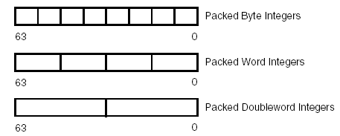
MMX Data Types
  64-bit data field, 3 types:

Slide 40
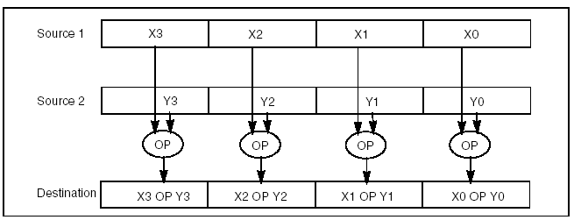
SIMD Execution Model
SIMD allows the same operation to be carried out on multiple data elements in parallel. The MMX technology supports parallel operations on byte, word, and doubleword data elements when contained in MMX registers.

Slide 41
Wraparound & Saturation Arithmetic
  Wraparound Arithmetic
    With ordinary unsigned arithmetic, when an operation overflows, the extra bit is truncated
    that is, the carry or overflow bit is ignored and only the least significant bits of the result are returned to the destination
    control the range of operands to prevent out-of-range results
  Saturation Arithmetic
    If addition results overflow or subtraction results underflow, the result is set to the largest or smallest value representable
    0 or 255

Slide 42
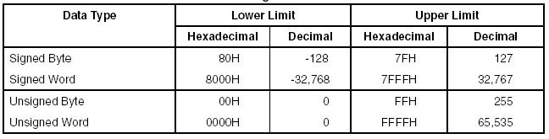
  Data Range Limits for Saturation

Slide 43
MMX Instructions
  The MMX instruction set consists of 57 instructions, grouped into the following categories:
    Data transfer
    Arithmetic
    Comparison
    Conversion
    Unpacking
    Logical
    Shift
    Empty MMX state instruction (EMMS)

Slide 44
Example
  Fade-out and fade-in in video application
  Algorithm :
    Result-pixel=A_{pixel} ×fade+B_{pixel} ×(1-fade)
    =(A_{pixel}-B_{pixel} )×fade+B_{pixel}

Slide 45
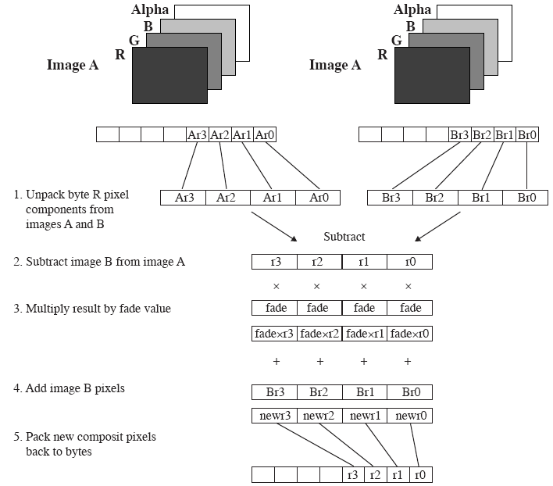

Slide 46
MMX Codes
  pxor mm7, mm7; zero out mm7
  movq mm3, fad_val; load fade value replicated 4 times
  movd mm0, imageA; load 4 red pixel components from image A
  movd mm1, imageB; load 4 red pixel components from image B
  punpcklbw mm0, mm7; unpack 4 pixels to 16 bits
  punpckblw mm1, mm7; unpack 4 pixels to 16 bits
  psubw mm0, mm1; subtract image B from image A
  pmulhw mm0, mm3; multiply the subtract result by fade values
  padddw mm0, mm1; add result to image B
  packuswb mm0, mm7; pack 16-bit results back to bytes

Slide 47
Specification
  8-bit pixel components are converted to 16-bit elements to accommodate the MMX 16-bit multiply capability
  If images’resolution is 640*480,and the dissolve uses all 255 possible fade values then, total number of instructions in MMX is 535 million, without MMX, is 1.4 billion

Slide 48
Notes
  Assemble language is needed
  50 cycles time is needed from MMX to floating point instructions
  Do your best to avoid shuffle usage of MMX and FP instructions

Slide 49
SSE
  SSE—Stream SIMD Extensions
    MMX2
  8 new 128-bit XMM registers
    SSE registers
  Used for Pentium III processor family
  Enhance the performance of IA-32 processors for advanced 2-D and 3-D graphics, motion video, image processing, speech recognition, audio synthesis, telephony, and video conferencing

Slide 50
SSE Instructions
  The SSE instructions are divided into four functional groups
    Packed and scalar single-precision floating-point instructions.
    64-bit SIMD integer instructions.
    State management instructions.
    Cacheability control, prefetch, and memory ordering instructions.

Slide 51
SSE2
  Streaming SIMD Extensions 2
  For Pentium 4 and Intel Xeon processors
  Enhance the performance of IA-32 processors for advanced 3-D graphics, video decoding/ encoding, speech recognition,E-commerce, Internet, scientific, and engineering applications
  144 new instructions,which support for:
    128-bit SIMD integer arithmetic operations.
    128-bit SIMD double precision floating point operations.
    Cache and memory management operations

Slide 52
Key points
Relationships between Instruction set, CPU and high-level language
Instruction types
What is 0 address instruction?
Which are types of operands?
Which are types of operations?
  Shift
MMX Instructions and applications
  Data types
  Functions of MMX instructions

Slide 53
Vocabulary
Bi-endian: 双端次序
Big endian: 大数在先
Little endian: 小数在先
Jump: 跳转
Operand: 操作数
Pop: 弹出
Push: 压入
Reentrant procedure: 可重入过程
Reverse Polish notation: 逆波兰表示法

Slide 54
Project
Using normal and MMX techniques to implement fade-in fade-out, comparing the time consume.
  Assemble language is needed
实验目的内容，实验过程（流程，核心函数等），实验总结以及程序代码

